Slide 1
Strassen Matrix Multiplication Algorithm
A Parallel Implementation
Honghao Tian
James Mwaura

Slide 2
Introduction
Published in 1969 by Volker Strassen.
Works on matrices of size 2^{n} x 2^{n}
Works by reducing the total number of multiplication operations.
3 main phases

Slide 3
The Algorithm
Phase 1
Phase 2

Slide 4
The Algorithm Contd.
Phase 3
Algorithm applied recursively at phase 2, till appropriate granularity is achieved.

Slide 5
Comparison to Regular Method
Normally, the process would be:
Strassen’s method reduces the number of multiplication operations to 7, from 8
Normal method: O(N³)
Strassen’s method: O(N^{2.8})
Possible downside: Reduced numerical stability

Slide 6
OpenMP Implementation
Recursive implementation in OpenMP
All iterative processes are parallelized.
Used 1, 2, 3 and 4 threads
Minimum granularity set at 64x64 Matrix size.
Highly memory intensive due to the numerous sub-matrices created in the recursive process.

Slide 7
OpenMPI Implementation
An extension of the openMP implementation
First round of the recursive process carried out in 7 processes.
Combined with openMP to speed up iterative loops

Slide 8
Recursive Function
C=A*B
M1
M1->M1
M1->M2
M2
……
M3
M4
M5
M6
M7
M1->M3
……
……
……

Slide 9
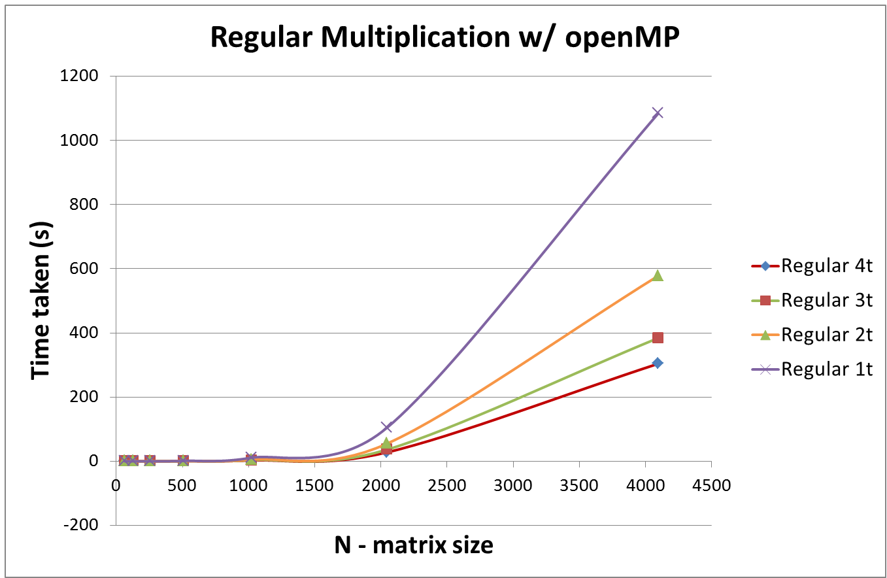
Results: Triple loop

Slide 10
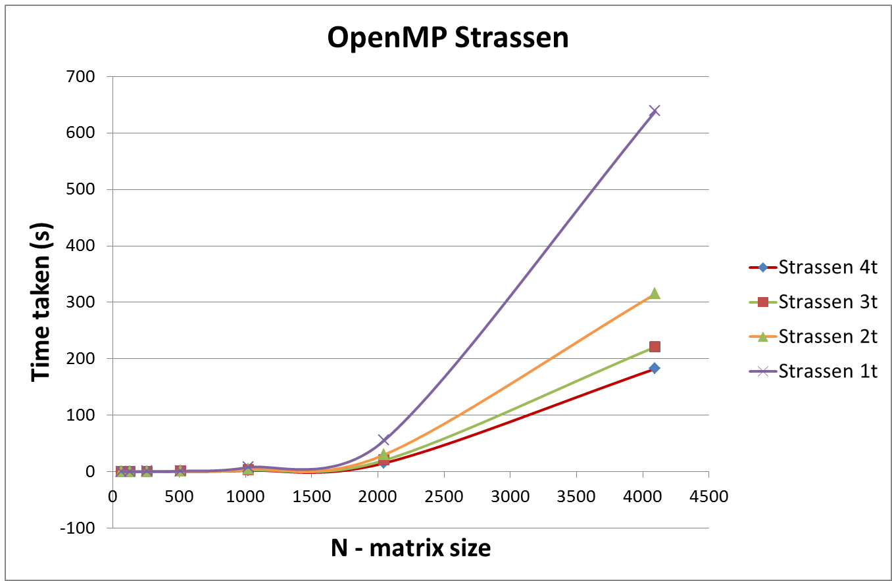
Results: OpenMP Strassen

Slide 11
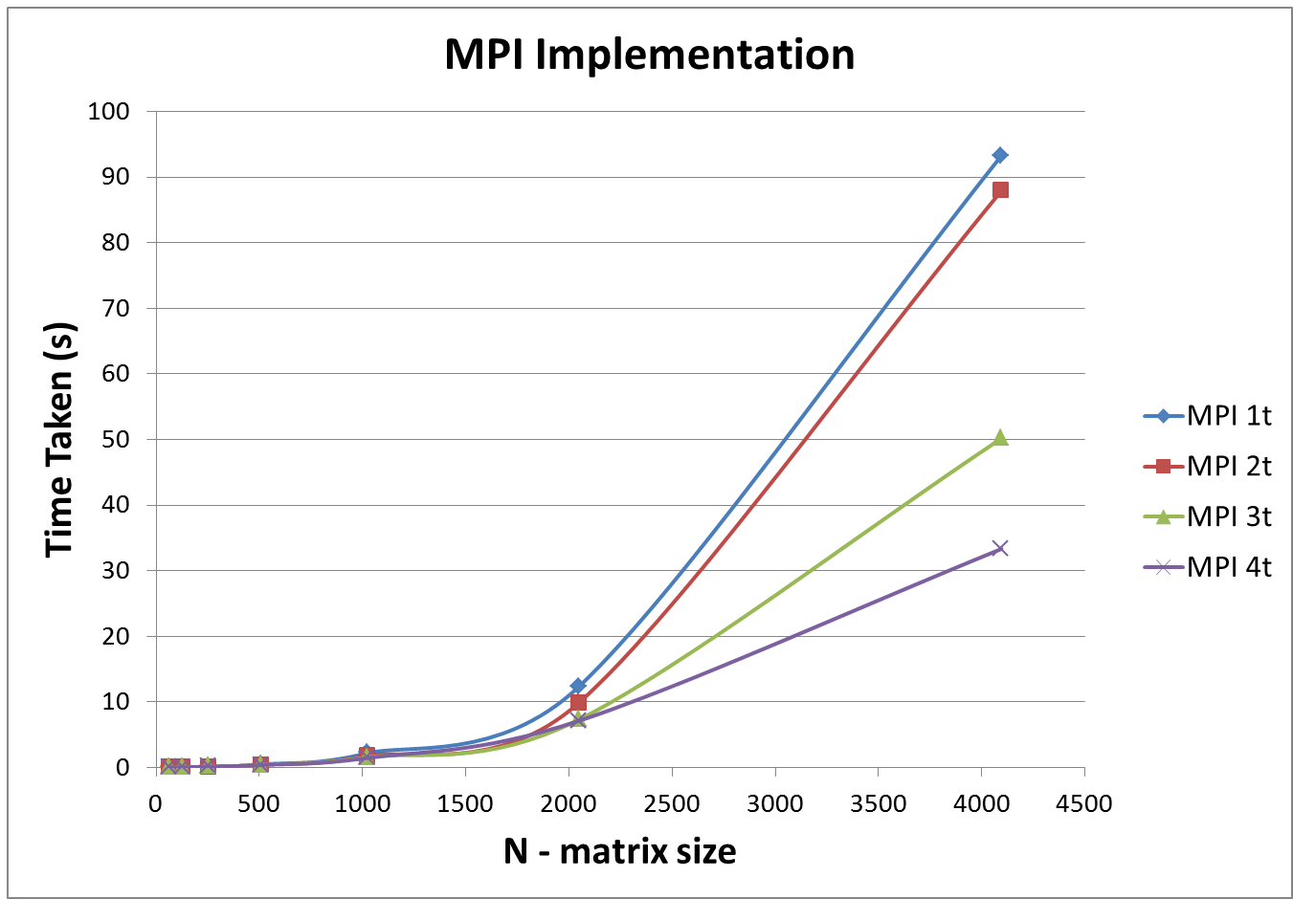
Results: MPI Strassen

Slide 12
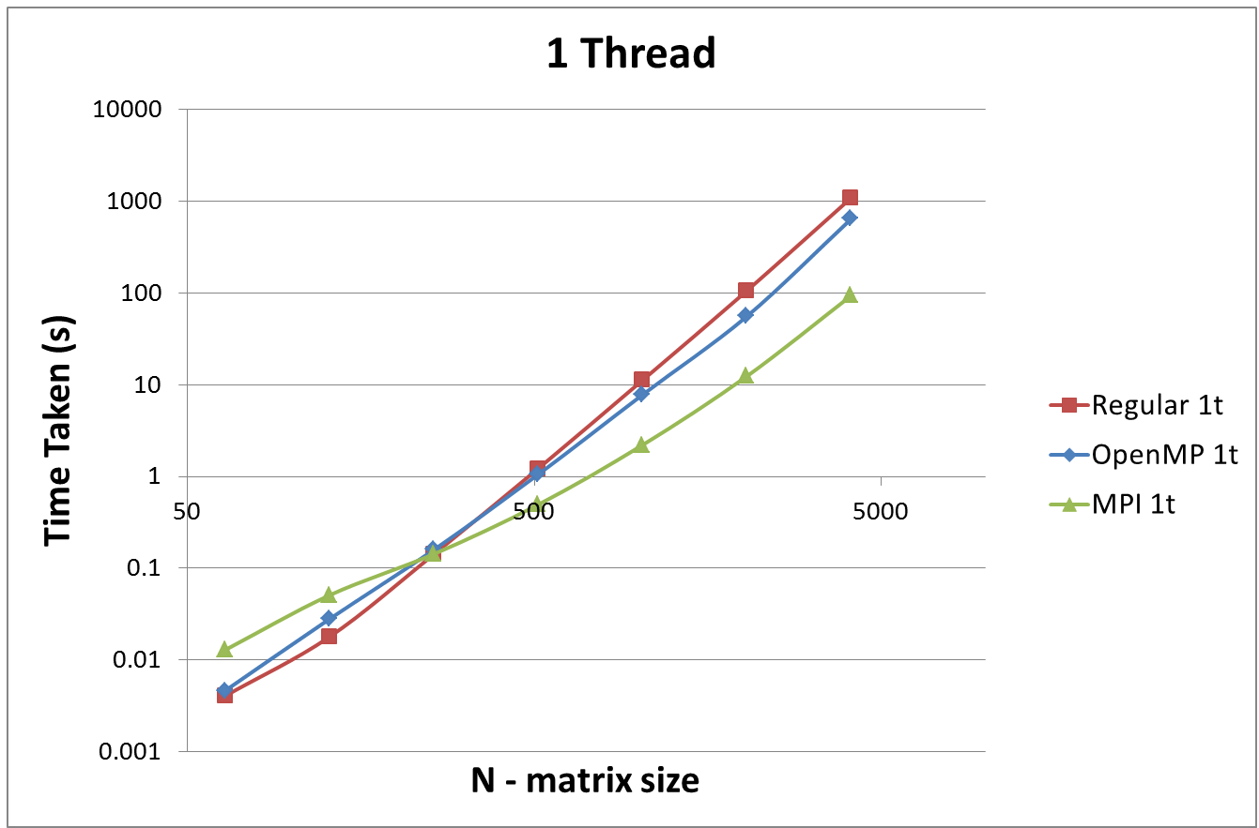
Results: Single-threaded

Slide 13
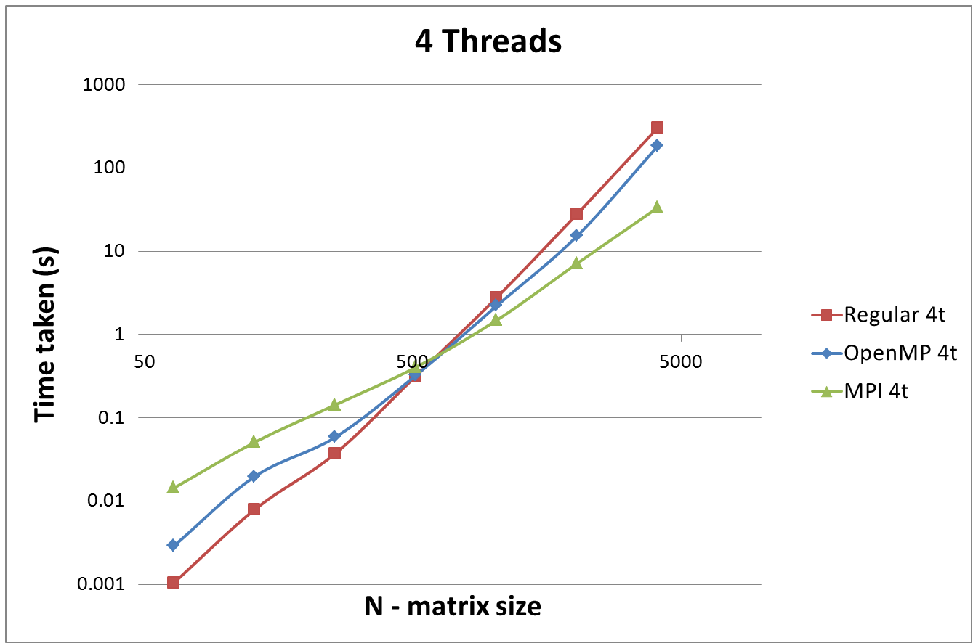
Results: Multi-threaded

Slide 14
Observations
Significant speedup for large matrices
Strassen algorithm slower for smaller matrices
A combination of MPI and openMP is the fastest.
Granularity changes for different matrix sizes to avoid memory overflow.

Slide 15
Questions?

